Slide 1


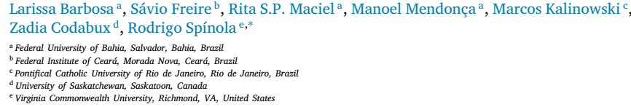
Attributes of a great requirement engineer
Lecturer: Dr. Nguyen Bao An
Presenter: Vo Thanh C
Tra Vinh, 04 January 2025

Slide 2
Contents
Introduction
Research method
Results
Discussion
Conclusion

Slide 3
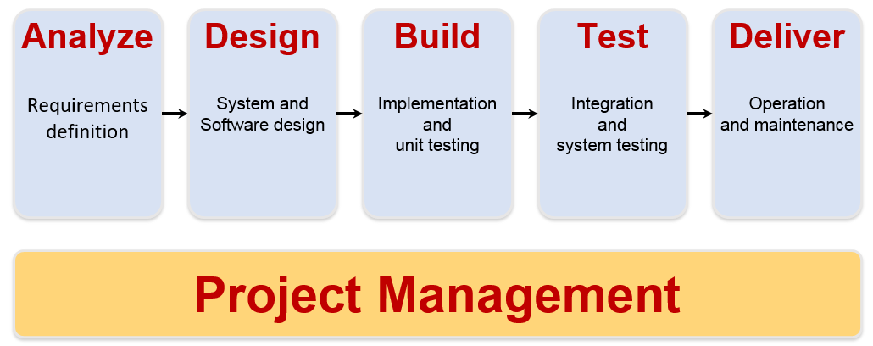
Introduction

Slide 4
Introduction
Several studies have investigated attributes of great software practitioners
However, the investigation of such attributes is still missing in Requirements Engineering (RE)
This work aims to investigate which are the attributes of great requirements engineers, the relationship between them, and strategies that can be employed to obtain these attributes

Slide 5
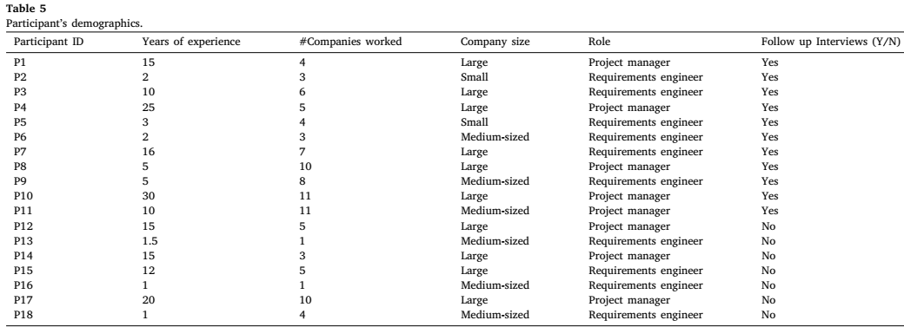
Research method
Survey (18 Participants) + Interview (11/18 Participants)

Slide 6
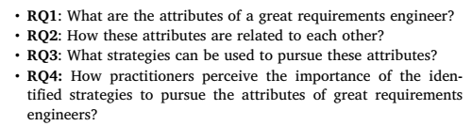
Research method
Survey (18 Participants) + Interview (11/18 Participants)
Research questions (RQs)

Slide 7
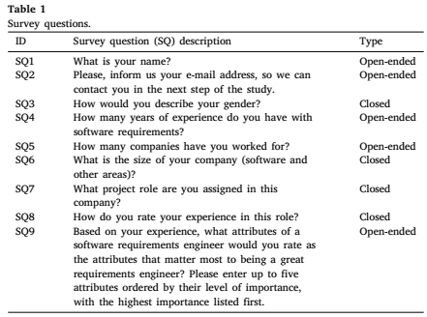
Research method
Survey on attributes of great requirements engineers

Slide 8
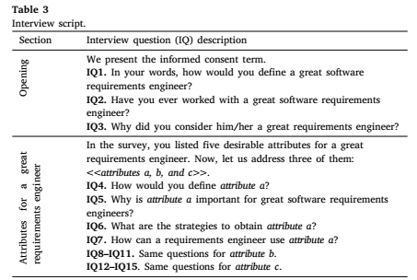
Research method
Interview

Slide 9
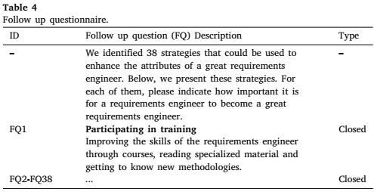
Research method
Follow up question on the importance of the identified strategies to pursue the attributes of great requirements engineers

Slide 10
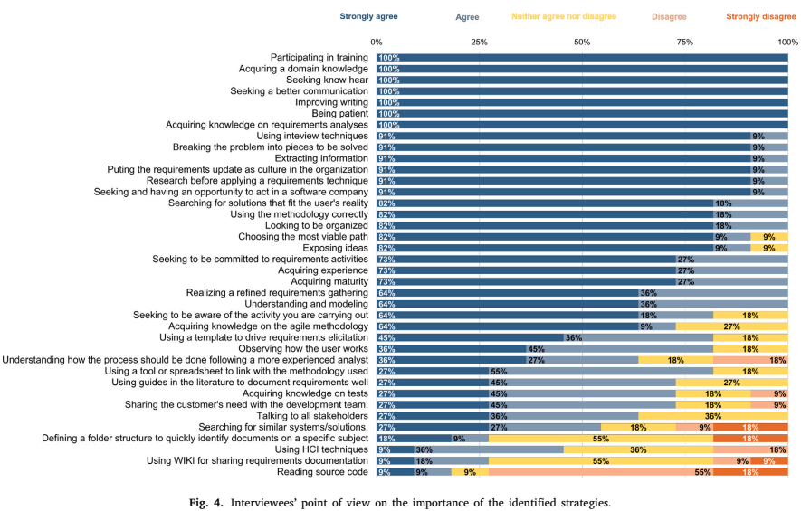
Research method
Follow up question on the importance of the identified strategies to pursue the attributes of great requirements engineers

Slide 11
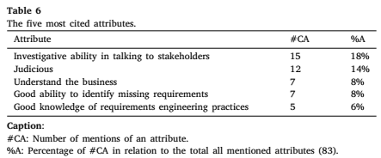
Results
RQ1: What are the attributes of a great requirements engineer?
Author identified 22 attributes of a great requirements engineer

Slide 12
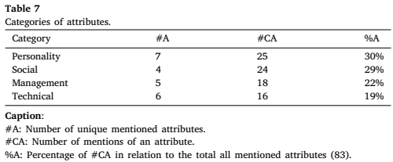
Results
RQ1: What are the attributes of a great requirements engineer?

Slide 13
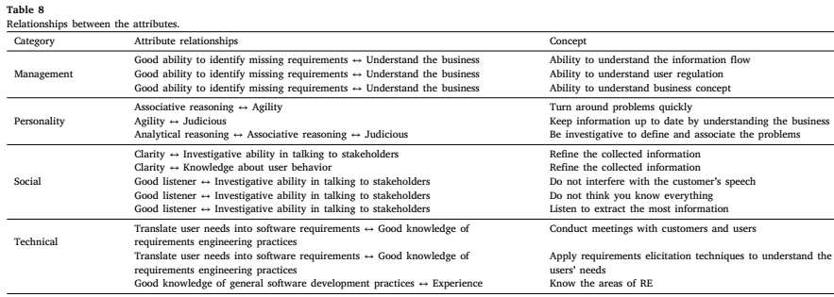
Results
RQ2: How these attributes are related to each other?

Slide 14
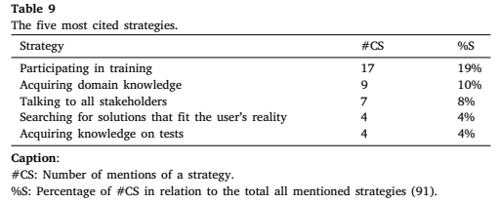
Results
RQ3: What strategies can be used to obtain these attributes?

Slide 15
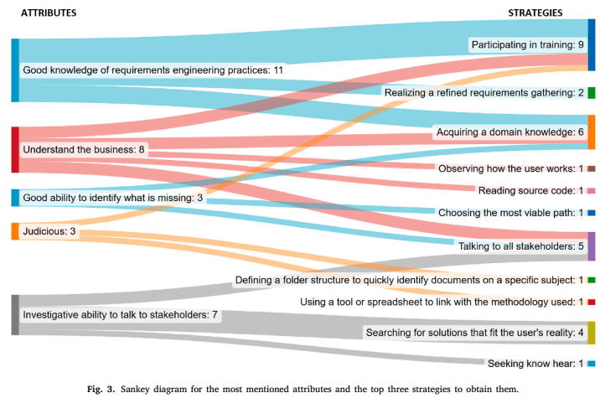
Results
RQ3: What strategies can be used to obtain these attributes?

Slide 16
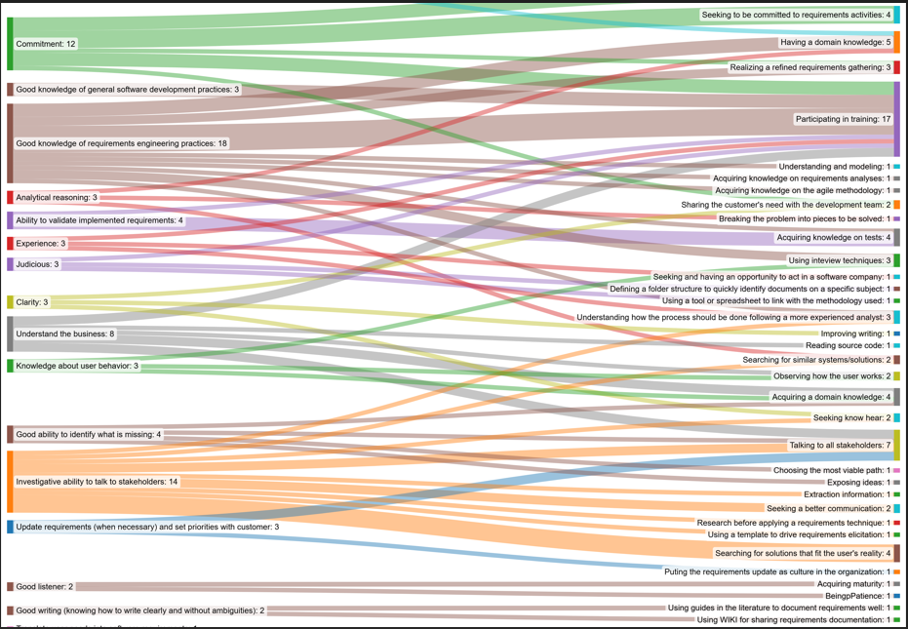
Results
RQ3: What strategies can be used to obtain these attributes?

Slide 17
Results
RQ4: How practitioners perceive the importance of the identified strategies to pursue the attributes of great requirements engineers?

Slide 18
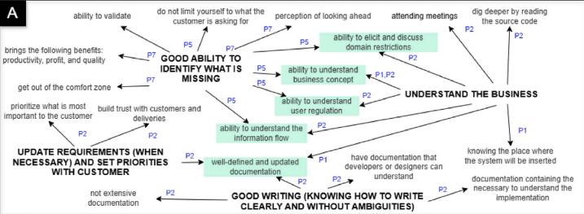
Discussion
Management Category

Slide 19
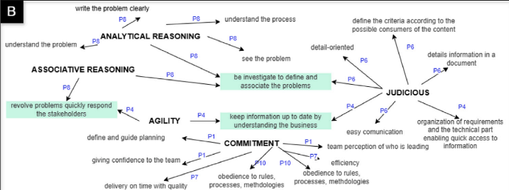
Discussion
Personality Category

Slide 20
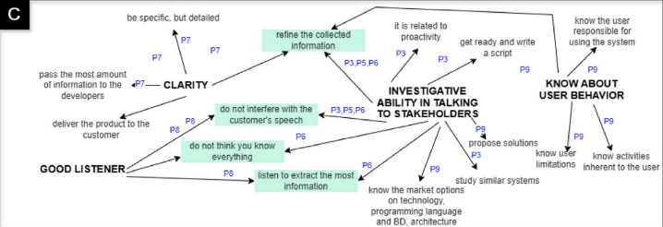
Discussion
Social Category

Slide 21
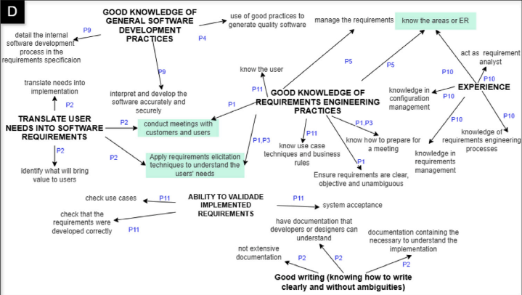
Discussion
Technical Category

Slide 22
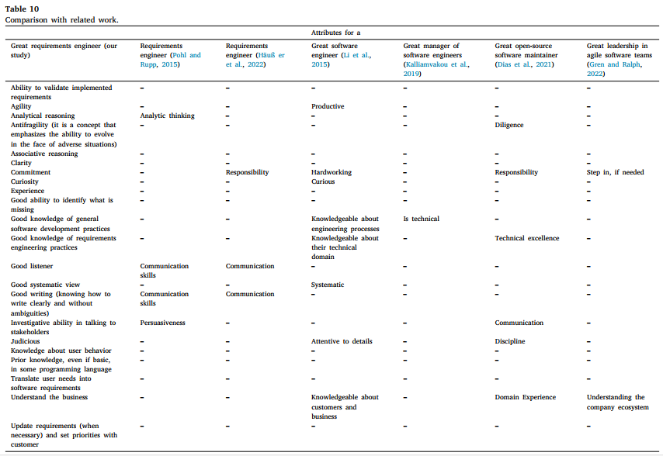
Discussion
Comparision with related work

Slide 23
Conclusion
This paper investigate the attributes of a great requirements engineer
Organize attributes into a map that can support software professionals in seeking strategies to become better requirements engineers
Open many opportunities of future work
Next steps of this research
Conduct a rating survey with requirements engineers and project managers aiming at understanding how they prioritize the identified attributes
Investigate undesirable attributes of a requirements engineer
Investigate teaching strategies that are suited to educate new requirements engineers considering both technical and soft skills
References: https://zenodo.org/records/13336394

Slide 24


